Slide 1


Welcome!
We will begin shortly.

Slide 2
Practitioner Training
SCOE SBMHW
Presented by Christopher Carrassi
HEALTHY CAMPUS ONBOARDING

Slide 3

Practitioner Training Agenda
CYBHI Overview
Healthy Campus Overview
Getting to Green
Platform Overview
  Documenting Student Sessions
  Working With Groups
Services & Clinical Discussion
Practitioner Profile Activation
Documenting Your First Service
Q & A

Slide 4
CYBHI
Overview
Additional resources available at support.healthycampus.com

Slide 5




🤝The Promise of CYBHI
Districts can earn reimbursement for services staff are already performing.
  No cost to parents & families
  Available for all insurance payers
  Large number of eligible practitioner types
  Grants available for capacity building
  No limits to many group services
  Districts are already seeing reimbursements!
CYBHI is the pathway to long-term sustainable behavioral health services in education.
7

Slide 6
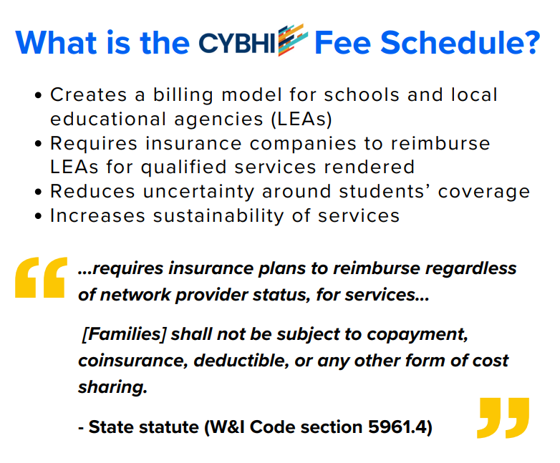

What is the Children & Youth Behavioral Health Initiative?

Slide 7
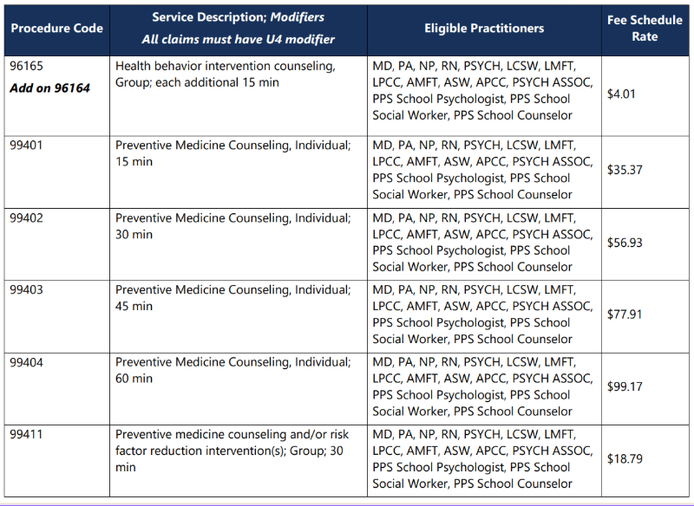
Fee Schedule

Slide 8
Healthy Campus: Who We Are
Additional resources available at support.healthycampus.com

Slide 9

⭐ The leading CYBHI-aligned EHR solution.
For schools, by schools.
🔗 SIS + Carelon (TPA) Integrations
Healthy Campus integrates with Carelon + all of the major SIS vendors to ensure clean claim submission with seamless data alignment among all platforms.
🤓 CYBHI Implementation Expertise
Healthy Campus supports schools in implementing CYBHI’s billing structure, simplifying the process and maximizing reimbursement.
💻 Healthy Campus Platform
Healthy Campus is the only EHR built from the ground up for CYBHI and education. Featuring a highly-customizable interface combined with top-flight security, the system works well for independent districts and large county-level consortia alike.

Slide 10






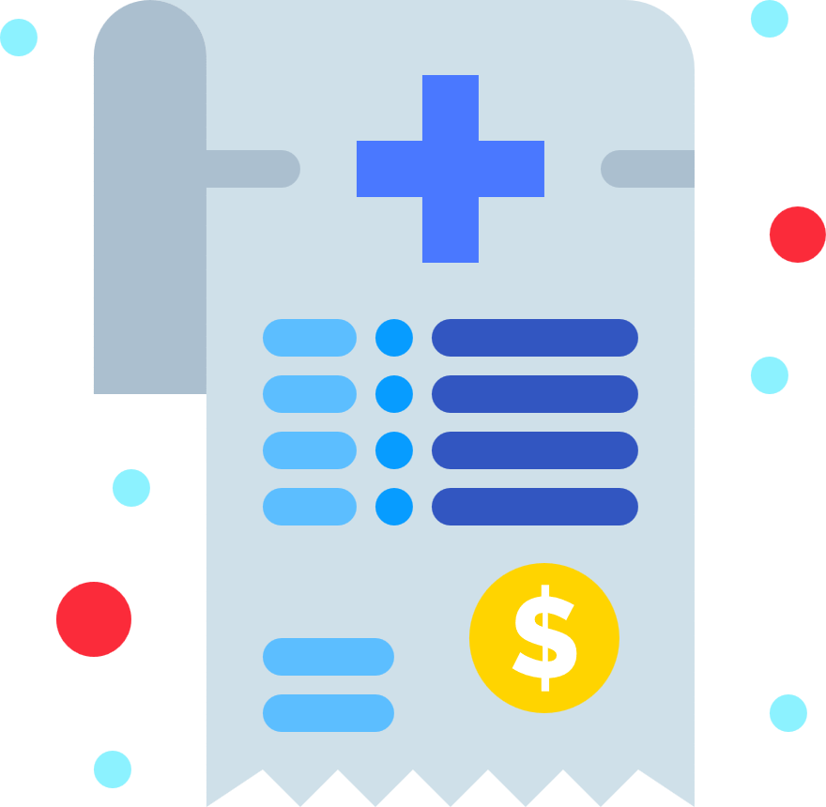


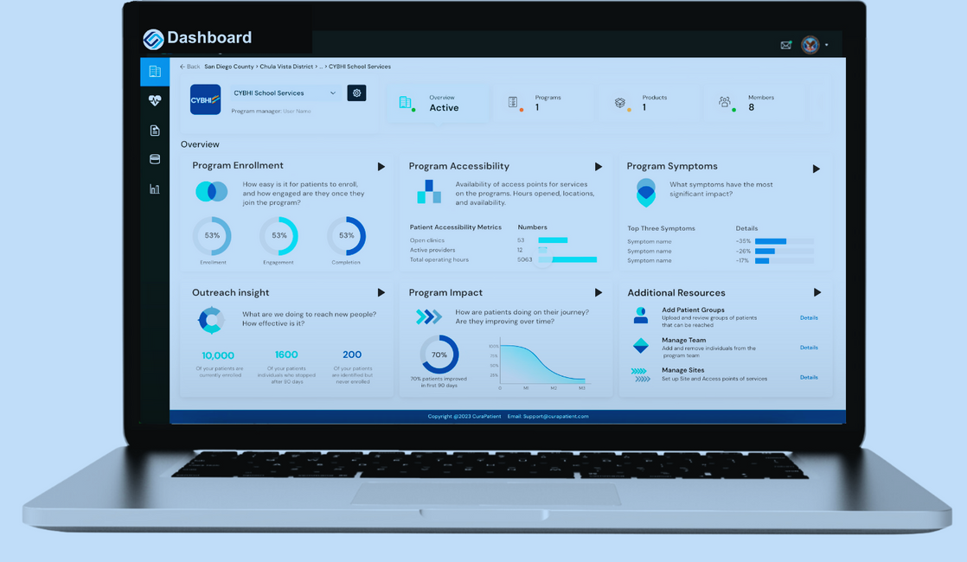





🎓 All-In-One Cloud-Based EHR For Schools
Scheduling and Care Coordination
Charting
Patient Portal and Consent Mgmt
Billing and
Claims Software
c
Student Data from Student Information System (SIS)
Data Dashboard/
Reporting Software

Slide 11




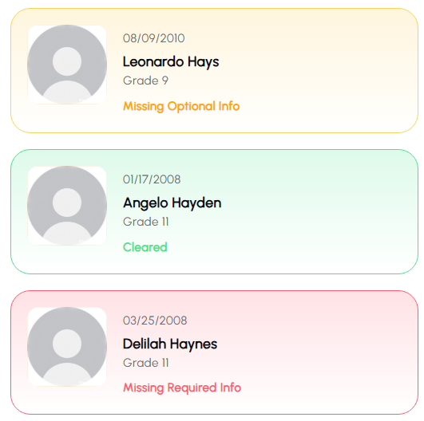
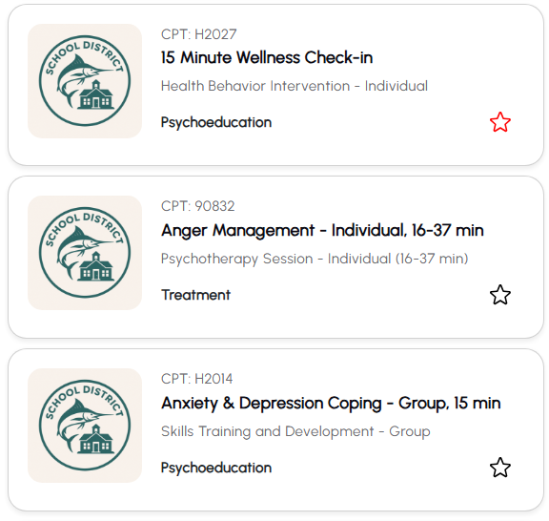
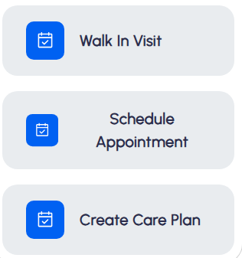
Reducing stress in three ways
Why Practitioners are Using Healthy Campus
  Student Clearance w/ Consent + Insurance
  Service Catalog Mapped to Codes
  Auto-Generated Claims From Services

Slide 12
Getting to Green
Additional resources available at support.healthycampus.com

Slide 13
Student Clearance Under CYBHI
  In the Healthy Campus Platform, student clearance is represented by the stoplight system.
  🟢 Green means a student is fully cleared
  🟡 Yellow means the student is missing some items
  🔴 Red means no consent has been collected
  .
  Requirements for Clearance:
  Insurance Information
  Consent to Treat
  Consent to Bill
  Medical Necessity
  Only 🟢 green students are eligible for claim submission.
The Stoplight System

Slide 14
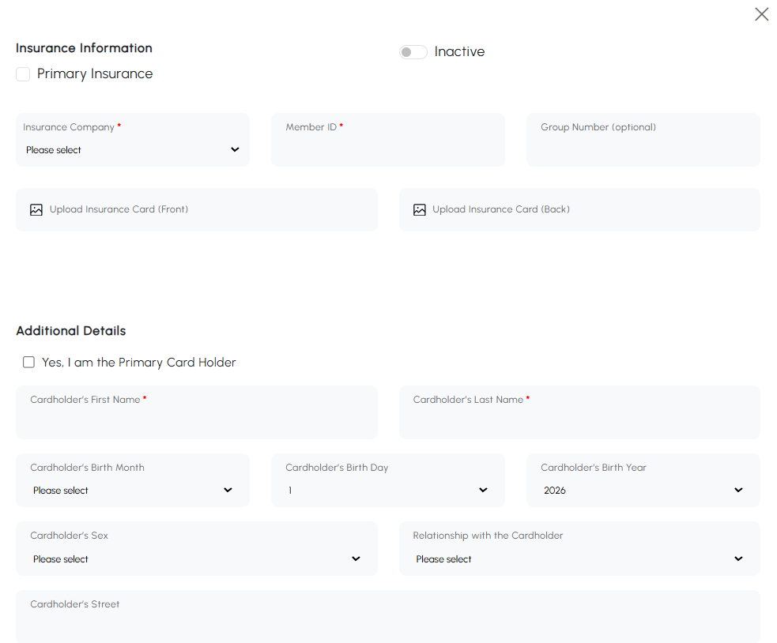
How is insurance collected into Healthy Campus?
  There are several ways insurance information can be collected:
      Via integration with your Student Information System (SIS)
      Entered by an admin or practitioner via the Student profile
      Provided online through the One-Click Portal
Insurance Collection
  Requirements:
  Insurance Company Name
  Member ID
  Cardholder First Name
  Cardholder Last Name

Slide 15
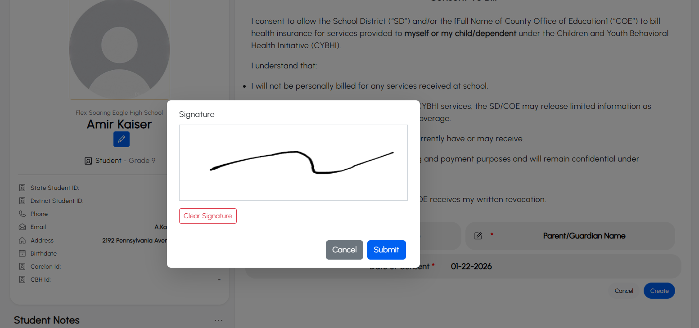
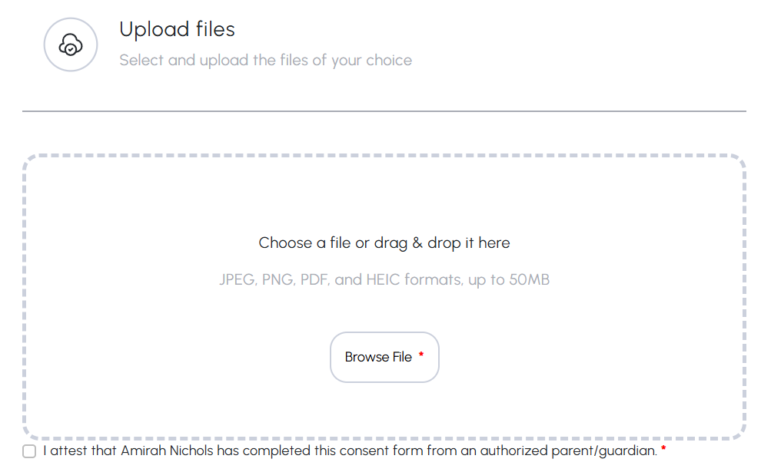
Collecting Signed Consents
  There are several ways consents can be collected:
    Via integration with your Student Information System (SIS)
    Entered by an admin or practitioner via the Student profile
    Provided online through the One-Click Portal
Consent Collection & Management
A Note on Minor Consent
  To conform to law, the platform allows Practitioners and Admins the option to sign a maturity attestation to allow 12+ age minors to self-consent

Slide 16
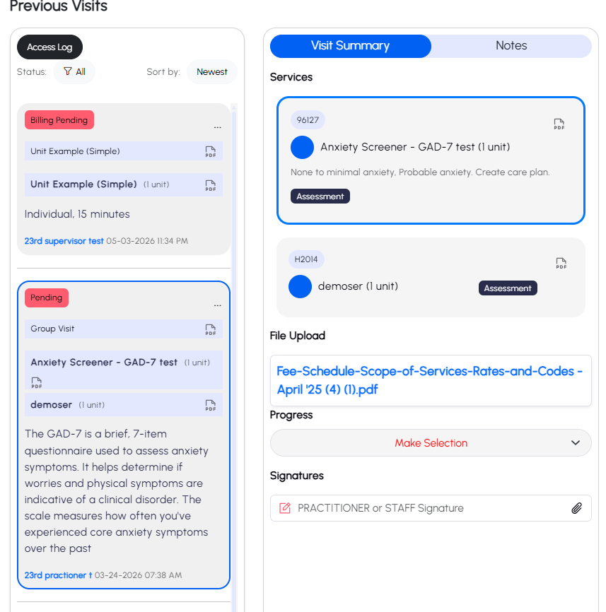
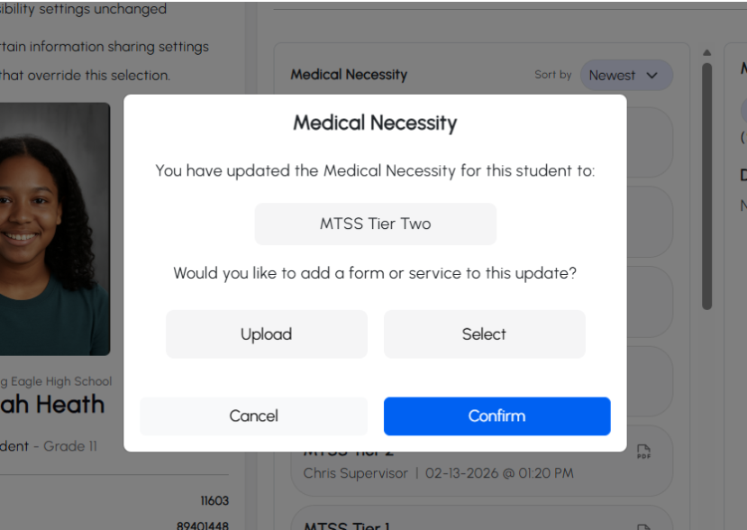
Medical Necessity
Can be collected and supported in several ways:
Upload Supporting Documentation
Reference a Prior Documented Session
Mass Upload

Slide 17
Platform Overview
Additional resources available at support.healthycampus.com

Slide 18

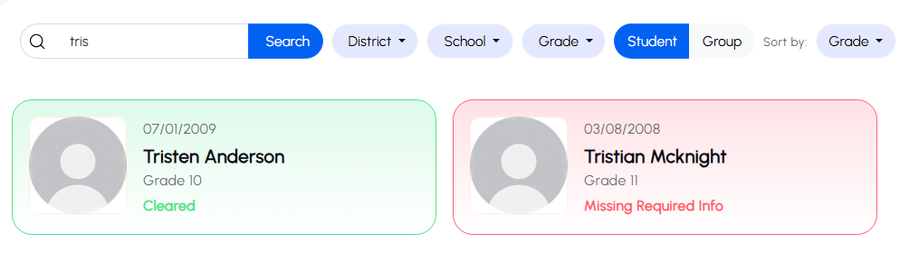
Student Profiles
  Data automatically populated via SIS and periodically updated for accuracy
  Stoplight system green / yellow / red for quickly identifying clearance
  Click on any student profile to:
    View demographic information
    View or complete insurance / consent information
    Check in a student for a walk-in or scheduled appointment
    Create a care plan
Student Lookup & Group Management

Slide 19
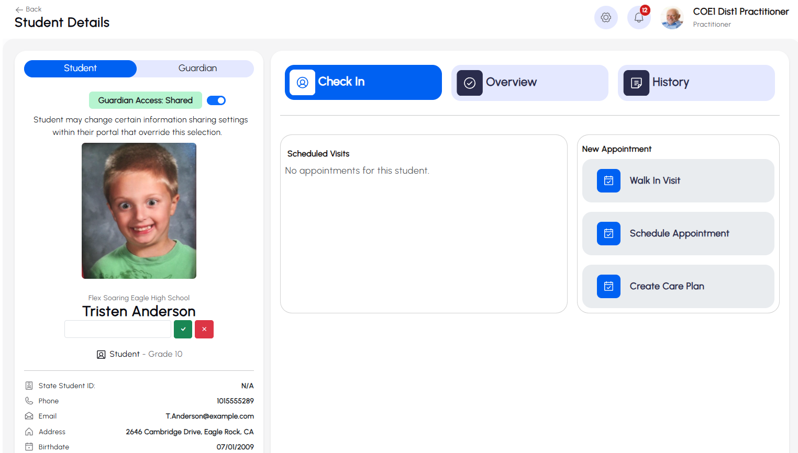
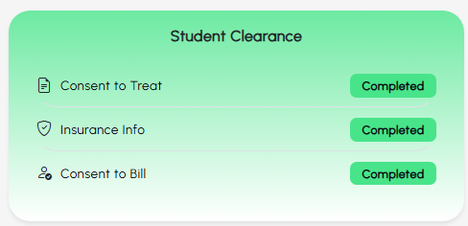
Student Profile
  View the student’s demographic info, check in for a session, and see all prior visits and notes
Student Lookup & Group Management

Slide 20
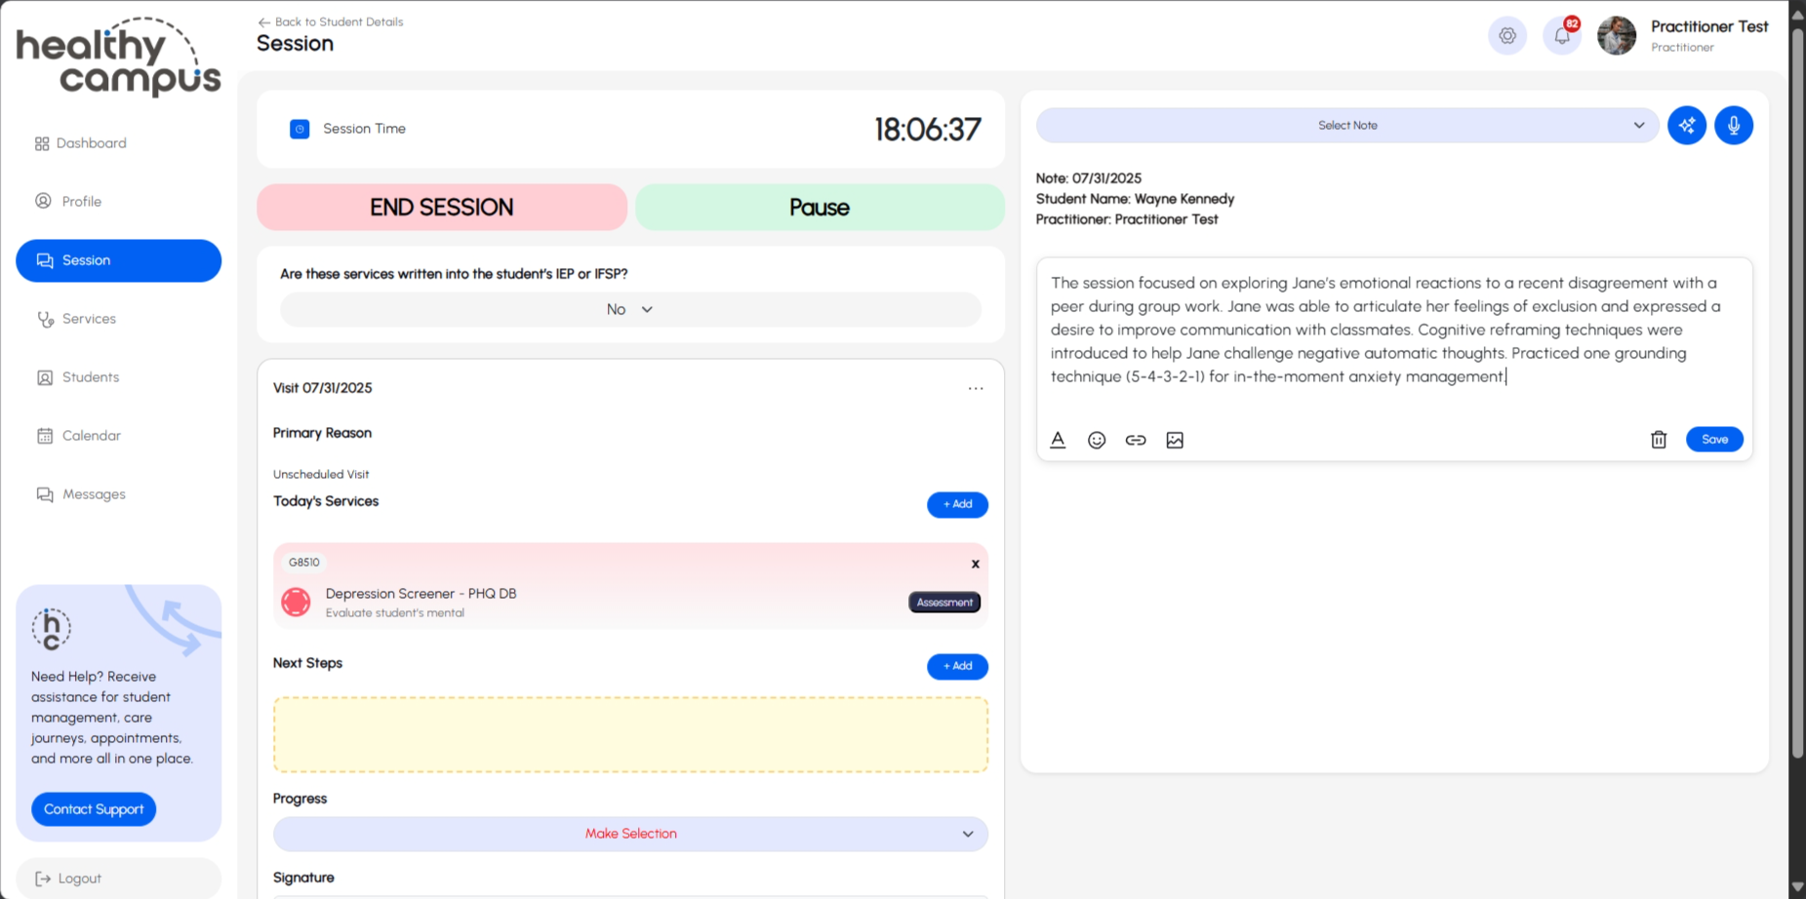
Student Sessions
  Choose from pre-built services to your sessions that come with billing codes and form fields already included
  Document notes that justify the services rendered
  Refer to your district policies and administration for further discussion around notation standards!
Student Sessions & Documentation

Slide 21
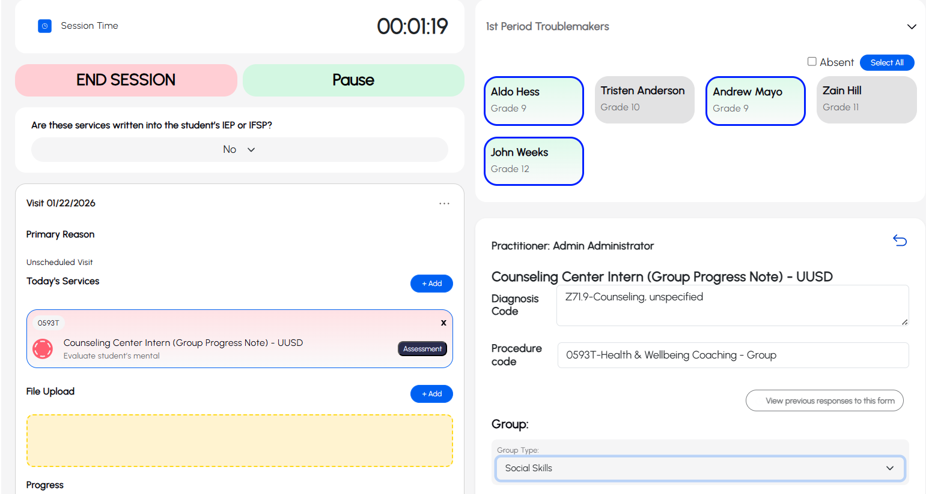
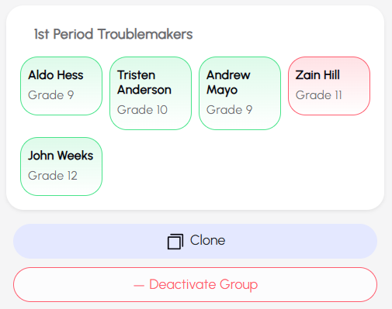
Group Sessions
  You can create, share, clone and manage groups of students
  Just like students, they have profiles you can use to check them in for services
  Take attendance & apply services to the entire group
Group Management & Documentation

Slide 22
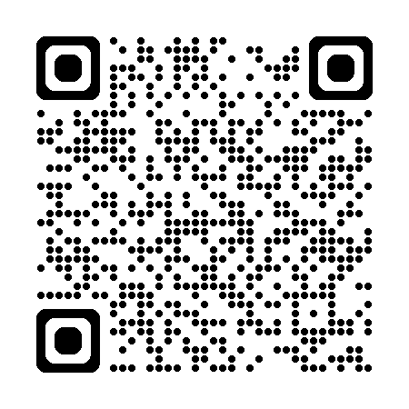
Platform Demonstration
Additional resources available at support.healthycampus.com

Slide 23
Practice Logistics
  Training Login:
  demo.healthycampus.com
    Username:
    practitioner
    Password:
    Admin@123
  Perfect for training and testing!
  Warning!
    Use the demo environment for all practice, training and testing purposes.
    Practicing in your live account will create a medical record
Ongoing Practice

Slide 24
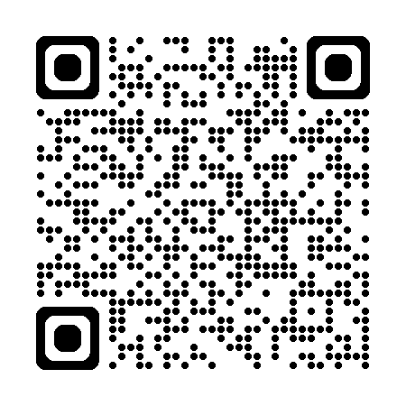
Log in to Your Healthy Campus Account
  Go to platform.healthycampus.com
  or use the QR Code --->
  Enter your district email
  Create your Long-Term Password
  (LTP)
  Receive & enter your
  One-Time Password (OTP)
  Click on your Profile tab to
  activate your profile
  Warning!
    This is your “live” account - do not use your live account for testing!
Platform (Live Environment)

Slide 25
Profile
Activation
Additional resources available at support.healthycampus.com

Slide 26
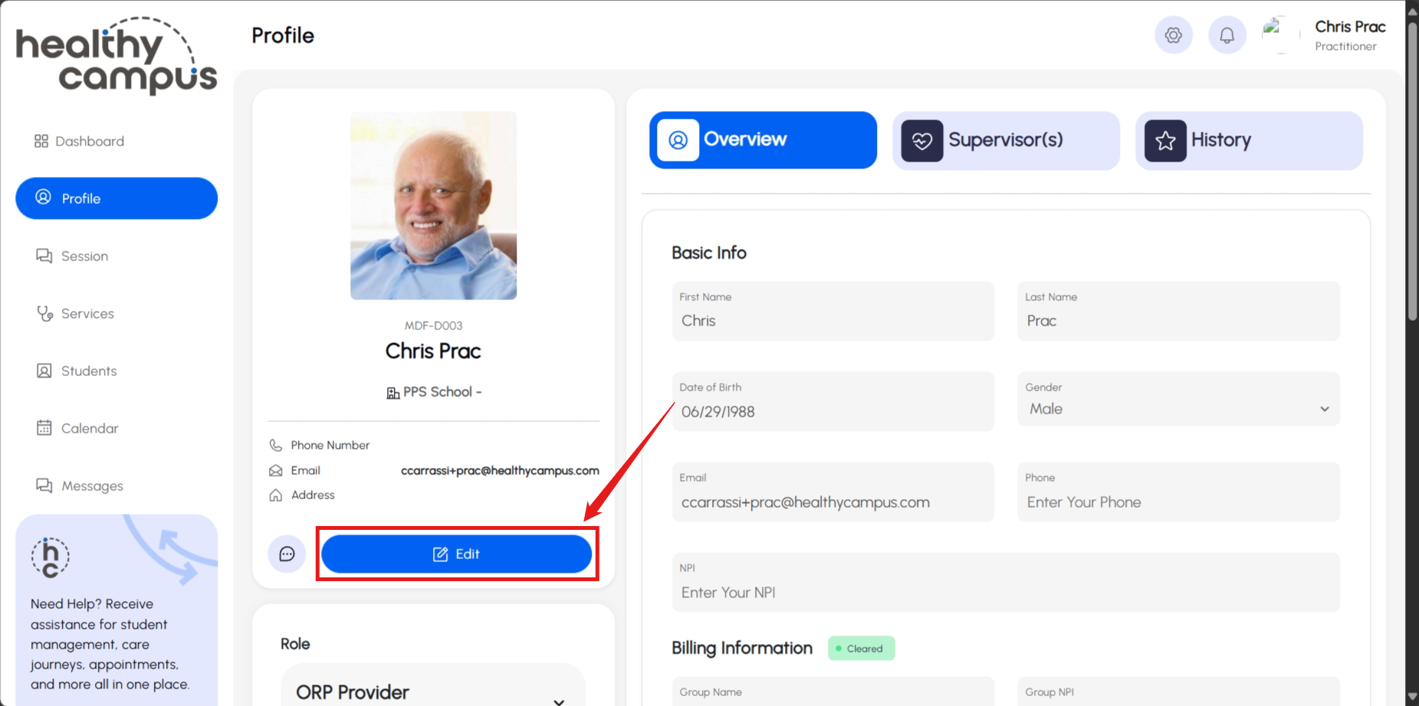
From the Profile Tab,
Click Update / Edit
Activating Your Profile

Slide 27

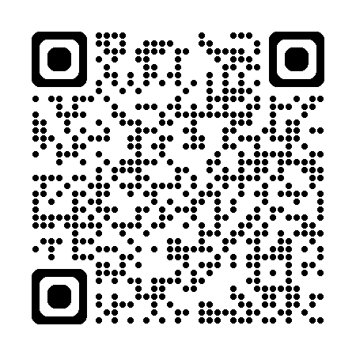
Required Profile Information
  Name / Birthdate / Gender
  Email / Phone
  NPI number
    required for all practitioners to participate in CYBHI
      Obtaining an NPI is easy!
      Apply via: nppes.cms.hhs.gov or use the QR code below
  Degree (i.e. PPS Counselor, LCSW)
  Specialty (e.g. S.SCL School-Related)
  Social #
For licensed staff, additional items are
required including your:
  Professional License #
  State Issued
  Effective Date
Profile Activation
Get an NPI!

Slide 28
Getting to 1-1-1
  1. Review services with supervisor
  - Confirm documentation expectations
  - Identify (at least) one actionable service
  2. Clear (at least) one student that will receive an actionable service
  - Consider family, family friends, or students with parents / guardians who trust you
  3. Document that service!
Documenting Your First Service

Slide 29

Q&A
Additional resources available at support.healthycampus.com

Slide 30
Obtaining Your NPI
Additional resources available at support.healthycampus.com

Slide 31
NPI Basics
An NPI number is a unique 10-digit identification number issued to healthcare providers by the Centers for Medicare & Medicaid Services (CMS). It is required for billing and ensures that services are appropriately tracked and reimbursed.
Personal Details: Full name, date of birth, Social Security Number (SSN), and contact information (phone number, email, and mailing address).
Professional Information:
  Professional credentials (e.g., LMFT, LCSW, LPCC, or other).
  License number and state of issuance.
Practice Details:
  Employer information (e.g., school district name and address).
  Taxonomy code for your specialty. The taxonomy code for mental health practitioners is typically 101YM0800X for "Mental Health Counselor." Verify this with your specific discipline.
Medicaid Information (if applicable): If you are already enrolled in Medicaid, have your Medicaid Provider Number handy.
Obtaining Your NPI

Slide 32
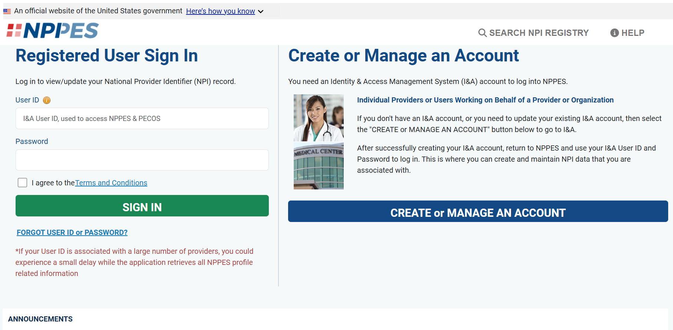
Step 1 – Create your account
1. Visit the NPPES website.
2. Click on “Create or Manage an Account” to begin the process.
3. Select “Create a Login” under the Identity & Access Management System (I&A) section.
4. Complete the registration by providing your personal information and creating a secure password.
5. Verify your email address by following the instructions sent to your inbox.
Obtaining Your NPI

Slide 33
Step 2 – Complete application
1. Log in to the NPPES portal with your credentials.
2. Click “Apply for an NPI for Myself” to start the application process. Make sure you apply for a “Type 1” NPI. If you are asked for an EIN, you are in the incorrect application.
3. Enter your personal and professional details, including: Full name and Social Security Number, License information, Taxonomy code (e.g., 101YM0800X).
4. Add your practice location: Use the address of the school or district where you work. Provide a valid phone number and email address.
5. Review the “Contact Person” section: This should be you or your school district’s designated billing contact.
6. Submit the application and review all entries for accuracy.
Obtaining Your NPI

Slide 34
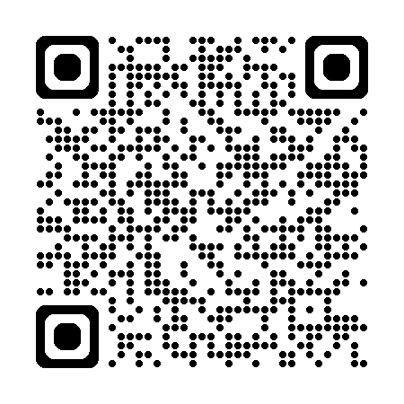
More NPI Resources
Call NPPES Support
800-465-3203
Watch a Video

Slide 35


Thank you!

